Slide 1
Gauge Software

Slide 2
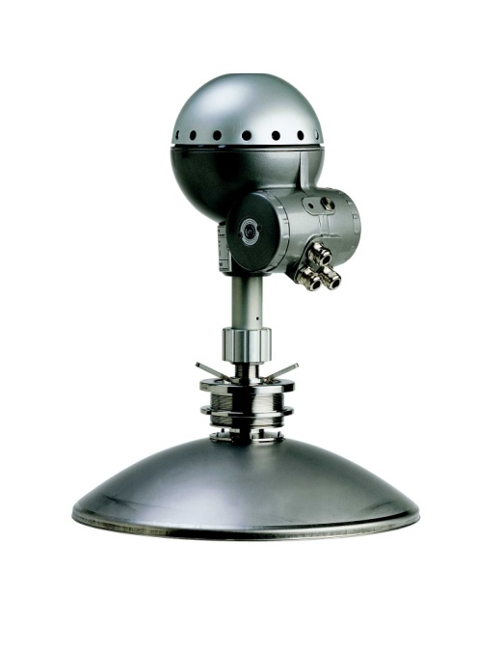
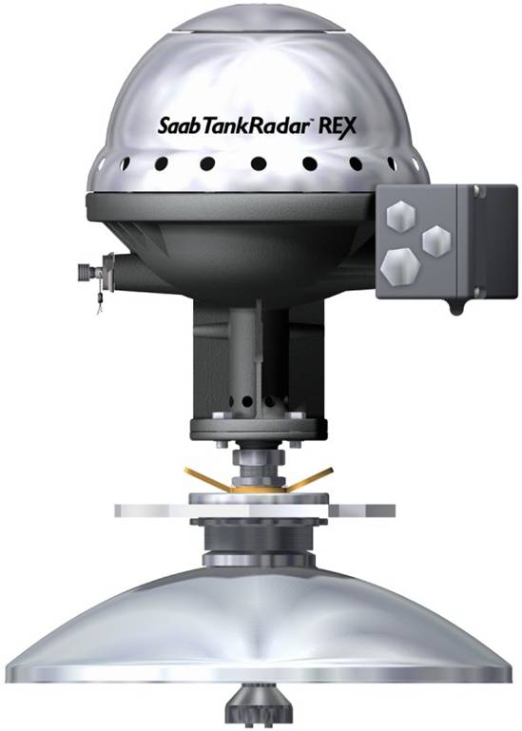
Gauge Firmware
REX & PRO

Slide 3
Gauge firmware
The gauge firmware consists of two parts:
Boot program
Application program
Both are stored in same memory chip on the processor board
In PRO, on the TGE-board
In REX, on the SPC-board
Notes:
Memory chip = FLASH Memory
FLASH ROM - A rewriteable ROM(ReadOnlyMemory) that doesn't lose its info when the power turns off.

Slide 4
Boot software
Manages serial communication
TRL/2 MODBUS
RS-485
FF
Competitor Emulation
HART Master and
SDAU / RDU 40 Interface
Start-up HW Tests.
Checks that Application software is OK
The boot sequence takes approximately 30 seconds for REX and 10 seconds for PRO

Slide 5
Application software
Measuring control
FMCW-sweep.
Signal processing.
LPG correction.
Measuring calculations
Level, Temp, Level Rate
Volume calculation.
HW detection and control
Temperature inputs.
Analog inputs/outputs.
Relay outputs.
Manages the parameter database.

Slide 6
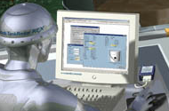
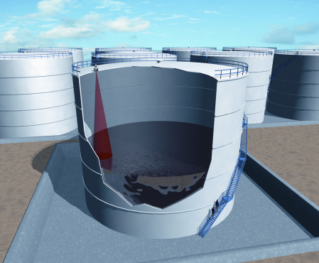
Signal processing overview
Holding
Registers
Input
Registers
Signal processor
Echo
Fixer
MET
Signal
FFT
Level
FHAST
Filter

Slide 7
Signal processing - FFT
FFT, Fast Fourier Transformation, calculates tank signal from frequency into distance.
FFT module tracks up to ten (10) echoes simultaneously
FFT calculation can provide approx +/-3mm accuracy for each echo.
FFT echoes are input to the Echo logics

Slide 8

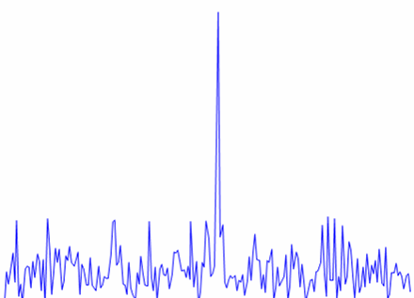
Signal processing - FFT
Signal Strength (mV)
Distance

Slide 9
Signal processing - FHAST
Advanced high accuracy filter
Used for increased accuracy as specified per RTG type.
TR REX has FHAST as standard
TR PRO has FHAST as an option
FHAST suitable for calm conditions (storage tanks) ONLY.
At turbulent conditions FHAST shall be OFF.

Slide 10
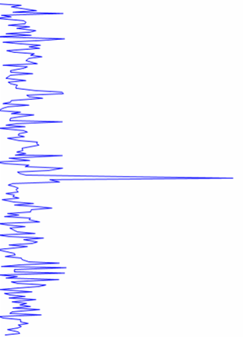

Signal processing - FHAST
FHAST
Filter
General Threshold

Slide 11
Echo detection, Initial Start up
This is what the gauge is doing:
Identify all valid echoes and create a list of these
Max ten echoes in the list
Match echoes against Rule database and give ‘No of Points’
Set ‘winner’ as Surface
Put a Tracking window around Surface echo
‘Close Dist’
Put FHAST window on surface echo for high accurate distance detection.
FHAST is optional sw in TR PRO
Notes:
At startup, gauge will identify all valid echoes and create a list of these
All echoes will be matched towards a rule database, where properties as, amplitude, distance, level rate i.e. will give each echo ‘a number of points’.
Echo with best ‘match’ (high points) will be selected as surface echo.
RTG will put a tracking window(‘FFT Match Threshold’) on the surface echo to track it within this.
RTG will put a FHAST window at surface echo for high accurate distance detection.

Slide 12
Echo detection, thresholds
Three different thresholds, The echo amplitude must be above all thresholds to be considered as a valid echo
Amplitude Threshold An “straight line” amplitude threshold that covers the full measuring range.
ATP Threshold Ten (10) Adjustable breakpoints, can be used to increase threshold in certain areas of the range.
CFAR Threshold A “floating” amplitude threshold. Defines how large an echo amplitude must be compared to the surrounding noise level.
1
2
3

Slide 13
Echo Tracking
In order to track an echo the gauge must be able to recognize an echo between consecutive measurements
Within FFT Match Threshold
Echoes outside FFT Match Threshold are rejected
For each new measurement the historical data is matched with the new data
FFT Match Threshold
Close Distance
Surface Echo
Other FFT Echo
Distance
Time

Slide 14
Echo Tracking, Lost echo
When Echo is lost, the Gauge will:
search for a new echo within Close Distance area
If no echo found, there are two different Search Modes that can be applied: Fast Search and Slow Search
Fast Search: Searches through the full range without considerations about previous surface echo position. The “best” echo will be selected as surface echo.
Slow Search: The search area expands linear with time. As soon as an echo is found within the expanding area it is selected as the new surface echo
Notes:
Slow Search: The search area expands linear with time; SearchArea = CloseDist + (T-T0)*SearchSpeed.

Slide 15
Disturbing Echoes
For accurate measurements, disturbing echoes shall not exist
If they do and it is not possible to remove them mechanically, PRO and REX can handle them if manually register them as Disturbing echo in the software
Before you register a false echo, make sure that...
It has an amplitude that is at least half of the surface echo amplitude
If you are getting the positions from the radar; it must be above the surface. If it is placed below the surface, the position will be displaced due to the dielectric constant of the liquid
The registered position must not deviate more than 100mm from its true position

Slide 16
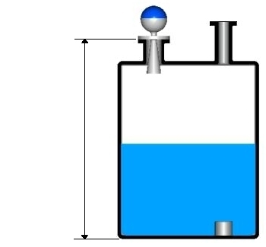
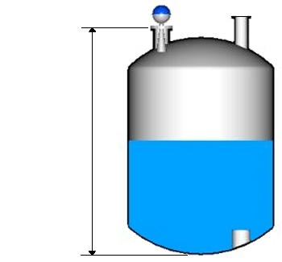
Empty Tank Handling
TankRadar REX.
Optimized for flat tank bottoms.
“bottom echo always visible” default ON.
Bottom projection function available
TankRadar PRO
Function driven by Tank bottom type settings.
Empty tank handler enabled for all “non flat” tank bottoms.
Bottom projection function available

Slide 17
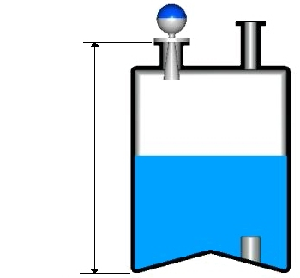
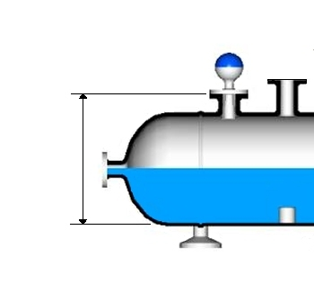
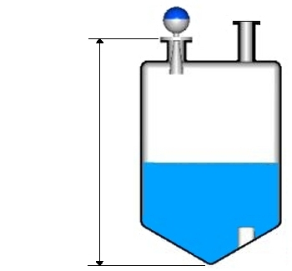
Empty Tank Handling
Selection drives settings for optimum Tank bottom handling and application conditions
Easy for user to select type of tank, rather than bottom handling parameters
TR REX does not have this feature

Slide 18
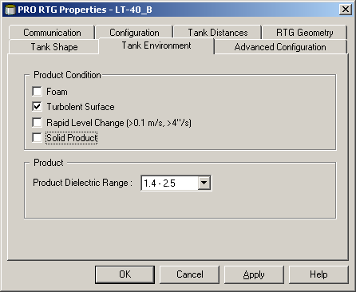
Tank Environment
Selection optimize settings for product condition in the Tank
Easy for user to set product condition, rather than changing parameters using Holding register
TR REX does not have this feature

Slide 19
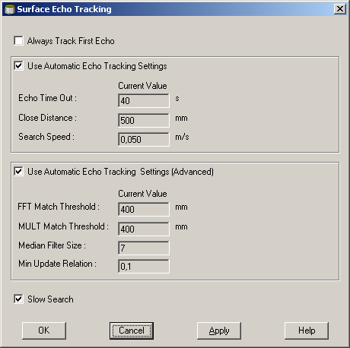
Surface Echo tracking
Parameters to use if settings in Tank Environment window is not helping
These will override selections made in the Tank Environment window
Notes:
Foam, turbulence, low dielectric constant makes the surface echo amplitude very weak.
If there are foam and/or turbulence there is normally also a problem to detect the echo each and every measurement.
The surface echo may be detected just a few percent of the total number of measurements.
In these measuring cases it is necessary to adjust some of the configuration parameters from their default value

Slide 20
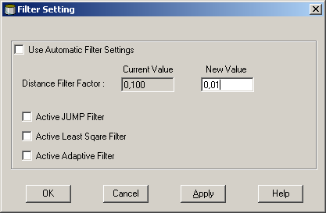
Filter Settings
Possible to adjust different filter settings:
Distance Filter factor
JUMP Filter
Least Square Filter
Adaptive Filter

Slide 21
Gauge Firmware
Raptor

Slide 22
RLG HW Block diagram
RLG Radar Level Gauge
Tankbus
TB Terminal Block (IS Barrier)
CM Communication Module
PM
Processor Module
RM
Radar Module
FISCO Power & Communication
SIL - Alarm
Communication
Power
Antenna
Notes:
SIL-alarm = kanske annan benämning?
RLG = ?

Slide 23
Gauge firmware
The gauge firmware consists of two parts:
Boot program
Boot exists in both RM and PM
Application program
Application exists in both RM and PM
Notes:
Memory chip = FLASH Memory
FLASH memory - Flash memory is a non-volatile computer storage technology that can be electrically erased and reprogrammed

Slide 24
Boot software
Boot software is stored:
PM and RM: in a FLASH memory
Task of PM and RM Boot is the same
Check if Boot software is ok
Check if software upgrade is scheduled
initialize hardware
test hardware, NVM and RAM memory
check if Application is ok
Start Application software
Notes:
NVM = FLASH memory - Flash memory is a non-volatile computer storage technology that can be electrically erased and reprogrammed
RAM = Read Only Memory

Slide 25
Application software in RM
RM, Radar Module, does the actual sweep, (after a request from PM) and sends the result (‘Tank signal’) to PM for further Signal processing
Measuring control
Generate FMCW-sweep.
Adjust hardware for Gain
Set correct IF-filter depending on selected antenna
Measure internal temperature

Slide 26
Application software in PM
PM request RM to generate a sweep and send the result (‘Tank signal’) back for further Signal processing
Basic Signal Processing
Level, Filtering
Applying FHAST filter
Measurement Logic
Echo detection/identification/selection/tracking
Amplitude Threshold, CFAR Threshold, ATP Threshold
Search routine, fast/slow search
Final Signal Processing
pipe correction
level rate calculation

Slide 27
Application software in PM, cont’d
LPG/LNG
Gas type correction
Temperature correction
Pressure correction
Volume calculations
Only basic ‘raw’ Level-to-volume
Tank Geometry
Tank Shape type
Tank Bottom type
Manage the parameter database
Holding/Input.

Slide 28

Signal processing overview
RM
Processor Module
Holding register
Input register
EchoFixer
Corrections
Filter
Thresholds
FFT
Level
Signal
FHAST
Filter

Slide 29
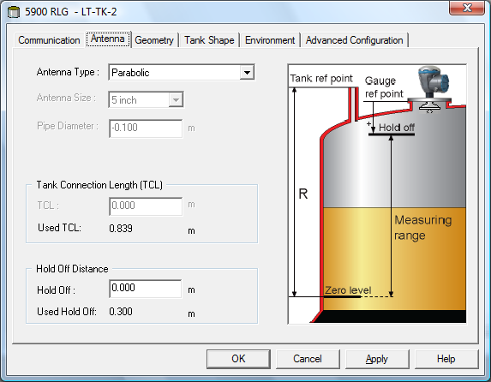
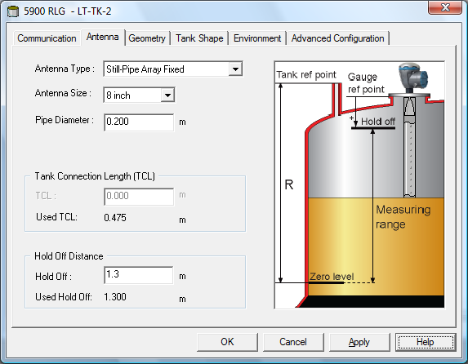
Antenna Selection
Selection of correct antenna is important for accurate measurement
Select for Still-pipe:
Correct array size
Accurate pipe inner diameter
Horn and Parabolic antenna is more straightforward
Notes:
Korrigering används alltid så fort pipe diameter > 0 oavsett antenn
IF-filter väljs till rörtyp om userdefined eller pipeantenn.

Slide 30
Antenna Selection, Pipe measurement
Propagation speed is lower in pipes than in free space.
Compensation is needed in order to maintain specified accuracy
Selection of Pipe antennas drives gain characteristics.
Pipe diameter drives propagation speed compensation.
Incorrect setting will give scale factor errors.
Propagation mode:
Linear mode: LPG/LNG
Low Loss Mode: Array Still-pipe
Notes:
Korrigering används alltid så fort pipe diameter > 0 oavsett antenn
IF-filter väljs till rörtyp om userdefined eller pipeantenn.

Slide 31
Antenna Selection , User defined
Predefined Antennas available for all types
When a predefined antenna is not available, User Defined Antennas can be selected
Depending on the Antenna type, the gauge will configure itself for the correct IF-filter type
No compensation needed

Slide 32
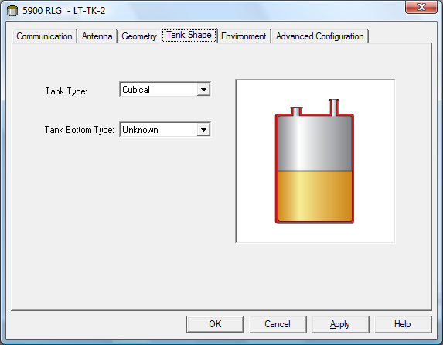
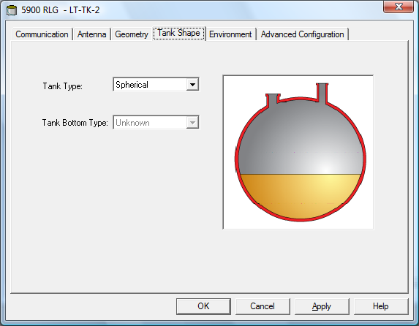
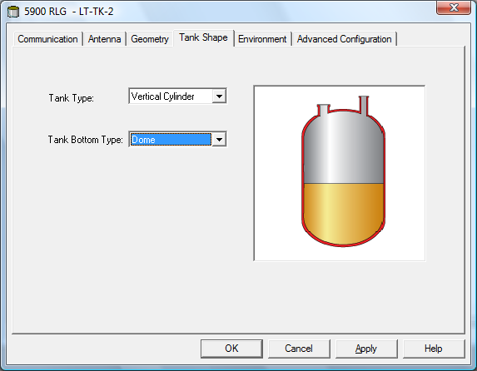
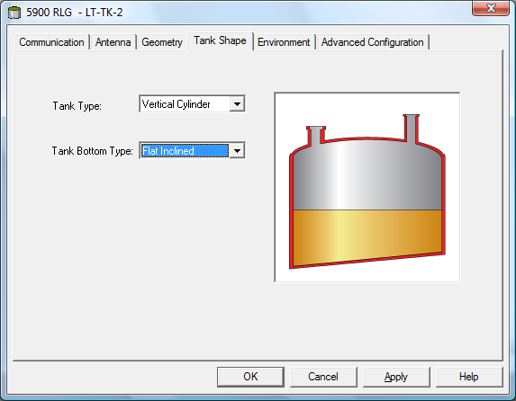
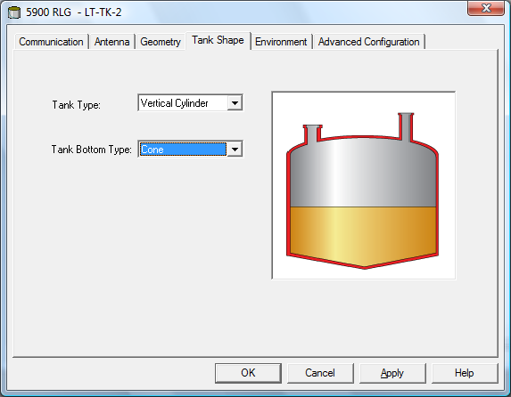
Tank Shape
Easy for user to select Tank type and Tank bottom type
Selection optimize settings for:
various tank geometries
measurements close to the tank bottom

Slide 33
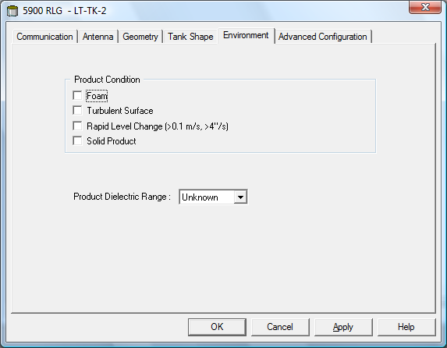
Tank Environment
Selection optimize settings for product condition in the Tank
Easy for user to set product condition, rather than changing parameters using Holding register
Foam
Turbulent Surface
Rapid Level Changes
Solid Products
Product Dielectric Range

Slide 34
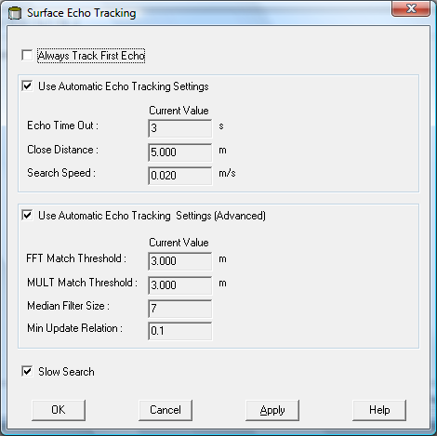
Surface Echo tracking
Parameters to use if settings in Tank Environment window is not helping
These will override selections made in the Tank Environment window
Notes:
Foam, turbulence, low dielectric constant makes the surface echo amplitude very weak.
If there are foam and/or turbulence there is normally also a problem to detect the echo each and every measurement.
The surface echo may be detected just a few percent of the total number of measurements.
In these measuring cases it is necessary to adjust some of the configuration parameters from their default value

Slide 35
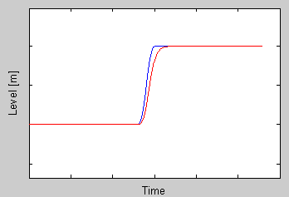
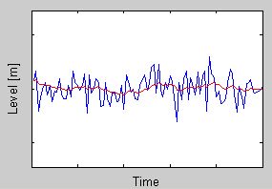
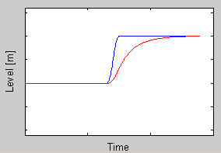
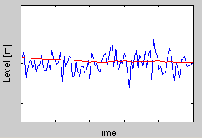
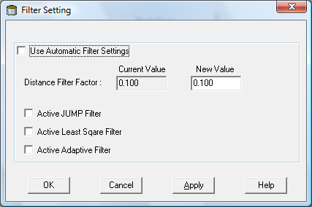
Filter Settings
Possible to adjust different filter settings
Distance Filter factor
This parameter defines how much the level value should be filtered in percent (1 = 100%).
A high value makes the device react quickly to level changes but the presented level value can be somewhat jumpy.

Slide 36
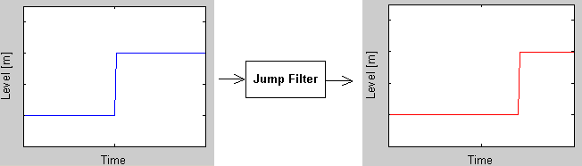
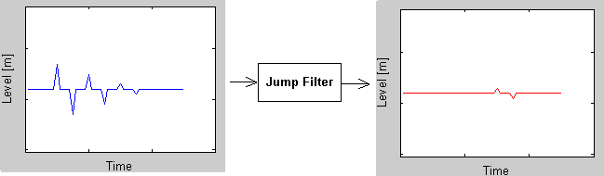
Filter Settings
JUMP Filter
If the surface echo is lost and a new surface echo is found this filter indicates to the device to wait for some time before it jumps to the new echo.
The Filter removes sudden jumps >100mm.

Slide 37
Filter Settings
Least Square Filter
This filter will give increased accuracy for slow filling or emptying of tanks. The level value will follow the surface with high accuracy and without delays as the level changes. When the level stabilizes at a certain level the filter makes the level move somewhat further before it aligns to the proper level value. This filter uses Distance Filter Factor as input. This filter can not be used at the same time as Adaptive Filter.

Slide 38
Filter Settings
Adaptive Filter
This filter automatically adapts to the movement of the level.

Slide 39
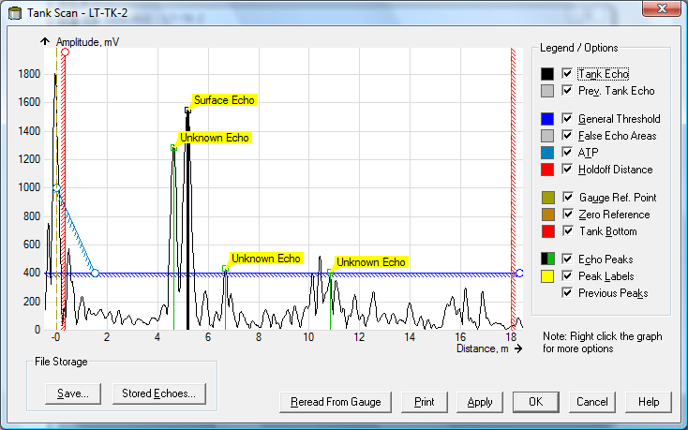
Advanced Config, Tankscan
Graphical view of echoes inside tank
Adjust Holdoff, Adjust Thresholds, Register disturbing echoes
Save Tank Scan to file
..and more
Notes:
Foam, turbulence, low dielectric constant makes the surface echo amplitude very weak.
If there are foam and/or turbulence there is normally also a problem to detect the echo each and every measurement.
The surface echo may be detected just a few percent of the total number of measurements.
In these measuring cases it is necessary to adjust some of the configuration parameters from their default value

Slide 40
Software Functions, 5900 / Rex / Pro
Function | 5900 | TR REX | TR PRO
Easy Antenna selection | Yes | Yes | Yes
Easy ‘Tank Geometry’ settings | Yes | No | Yes
Easy ‘Tank Shape’ setting | Yes | No | Yes
Easy ‘Tank Environment’ settings | Yes | No | Yes
Empty tank handling | Yes | Yes | Yes
Full tank handling | Yes | No | Yes
Double bounce | Yes | No | Yes
Tank bottom projection | Yes | No | Yes
Double surface | Yes | Yes | Yes
Filter settings | Yes | No | Yes
Volume calculation (simple) | Yes | Yes | Yes
Hybrid calculation | Yes, when connected to 2410 | Yes | No
LPG correction | Yes | Yes | No

Slide 41
Upgrade Firmware
Why?
Fix a problem related to sw malfunction(’bug’)
New feature wanted (i.e. Bottom Projection)
New function wanted
New hardware revision requiring new sw version
....more?

